Slide 1
The UX of no devices
Claudia Gutiérrez UXPA 2014 - London

Slide 2
The Computer for the 21st Century Mark Weiser Chief Technology Officer at XEROX PARC Scientific American Magazine, September issue
1991

Slide 3
The Computer for the 21st Century
The Computer for the 21st Century
Boards
Pads
Tabs
Notes:
Paper by Mark Weiser that talks about the existance in that time of the existance of tabs, pads and boards. Tabs related to post it notes sized techonologies, pads like Tablet tecnhologies and boards as desktop computers or Smart TVs
In this papers he refers to the ubiquitous computing concept, computers that we carry around and are invisible, seemless technology that he summarizes in the concept of embodied virtuality.

Slide 4
The Computer for the 21st Century
The Computer for the 21st Century
Ubiquitous computing
Seemless technology
Embodied
virtuality
Notes:
Paper by Mark Weiser that talks about the existance in that time of the existance of tabs, pads and boards. Tabs related to post it notes sized techonologies, pads like Tablet tecnhologies and boards as desktop computers or Smart TVs
In this papers he refers to the ubiquitous computing concept, computers that we carry around and are invisible, seemless technology that he summarizes in the concept of embodied virtuality.

Slide 5
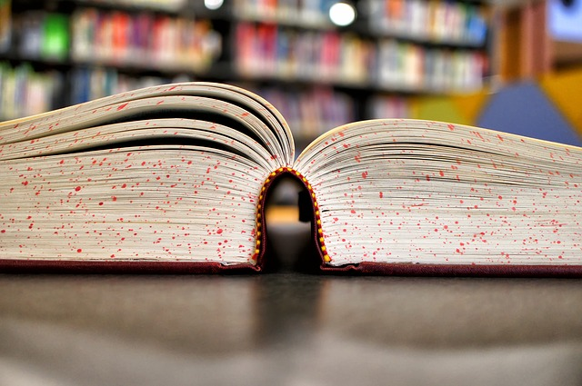
With devices disappearing…
We take our world
beyond computers
Notes:
What Weiser remarks and what is really interesting from this paper done 23 years algo is that he thought of the idea that most profound tecnologies are those that disappear, because when people know something sufficiently well they cease to be aware of it. With devices disappear8ing, we take our world beyond computers, so

Slide 6
UX OF NO DEVICES
2019
Notes:
So how does that bring us to 2019? In 5 more years: We need to activate our world through computers.

Slide 7
Activate our world through computers
Notes:
It`s not that we trigger things through computers, is the computers that are activating our world.

Slide 8
UX of NO Devices:
UX of NO devices
Redefinition of the relationship between user and the interface
The practice of UX by UXers
Notes:
And that change involves two facts: A redefinition between the user and the interface and a change on how we UX practitioners practice UX.

Slide 9
User and the interface
HUMAN AS THE INTERFACE:
Is all about the user and not the device

Slide 10
Notes:
Lets see three examples on how we are making that transition.
First is Google Glass. With the release of Google Glass to commercial sell on april this year, we are trying to go apart from the physical device, but we are still relying on it to perform actions.

Slide 11
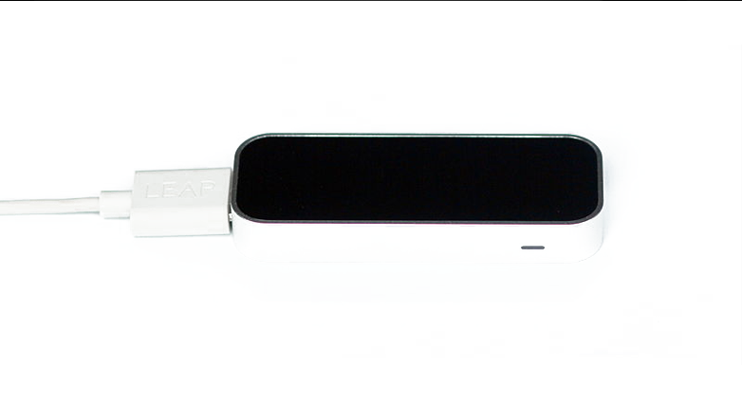
Notes:
Some transitional example is Leap Motion. This device let us tracks our hands and 10 fingers to help us interact with the screen with our common gestures to swipe, play or draw among many other activities without touching the screen. There is no physical device involved, but we still need to rely on the tool..

Slide 12
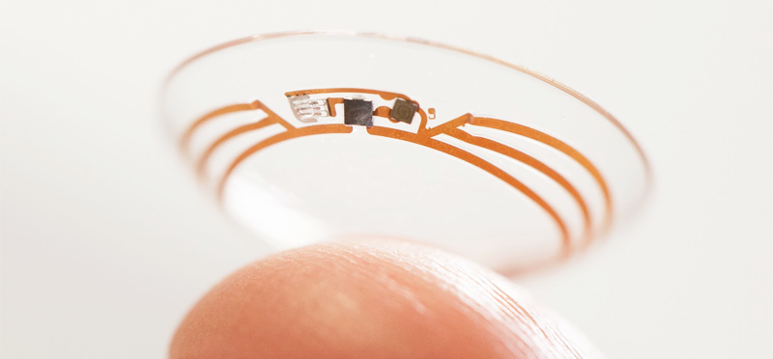
Notes:
With the new release of Google Contact Lenses that can control the sugar level of diabetic patients, the interface is totally erased.

Slide 13
Added value in our world:
Enhancement
Notes:
The common activity of wearing a contact lens is enhanced to deliver an added value for our world. Is the activation of our world through computers.

Slide 14
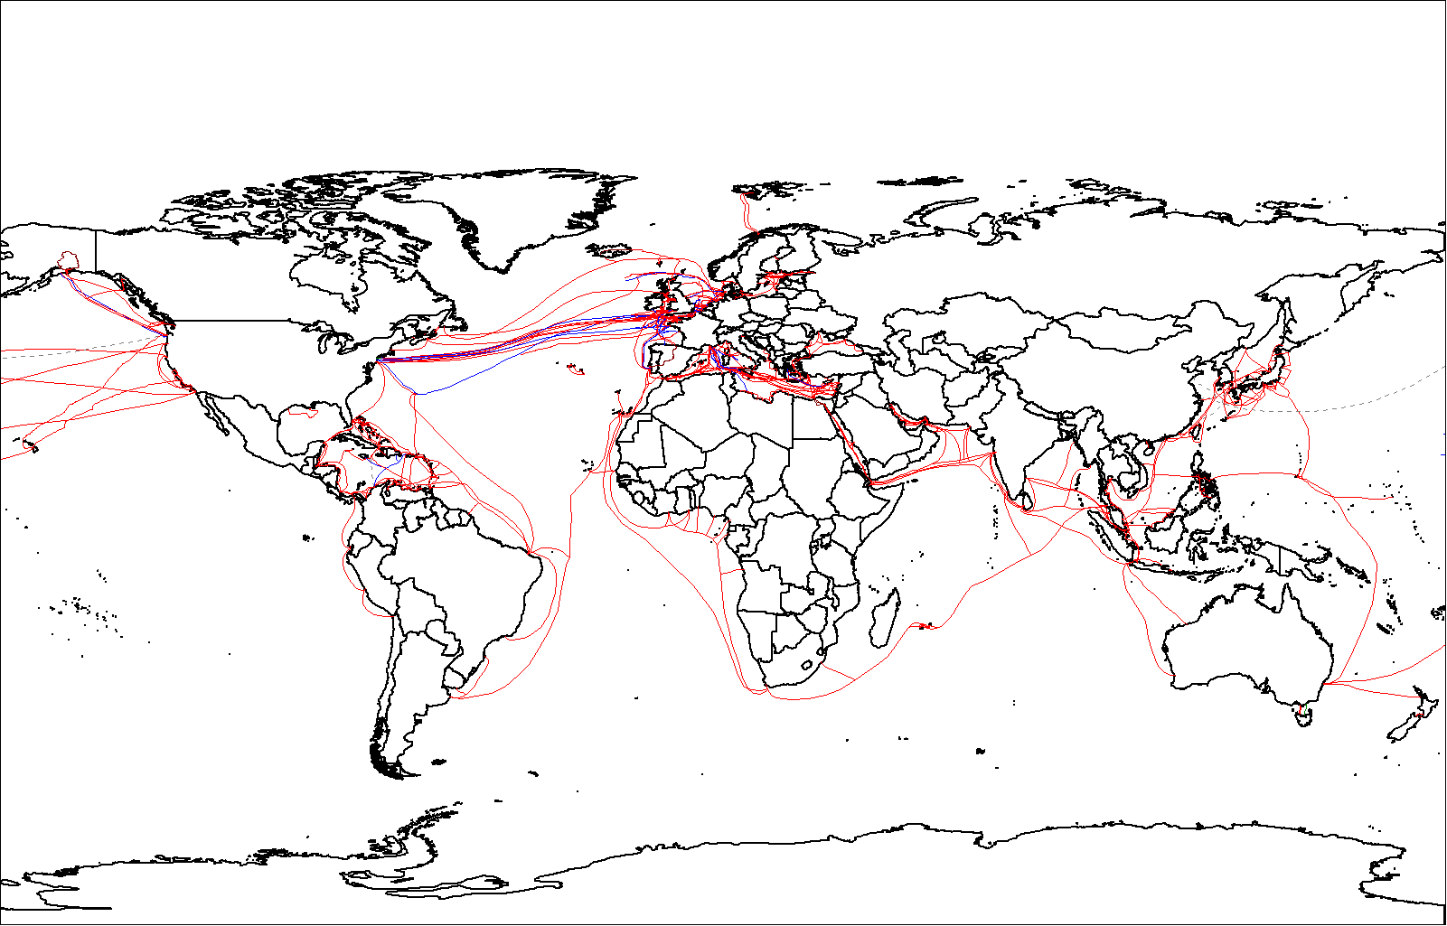
Notes:
So what happens when we understand the human as the interface and the transparency of devices? Due to increased connectivity in a wifi networked world we are in the need to understand tecnhology as the enhancement of our world.

Slide 15
Human as the interface
Understand Supportive computing
Supports human functions
instead on adapting human to technology
(Pivotal Labs)
Notes:
So we need to understand 2 main facts: That computing supports the human functions and enhances then and is not the human that adapts to the technology. Technology as the enhacement of our world.

Slide 16
Human as the interface
Deliver a Proactive UX
Anticipate the needs of humans
Notes:
And that we need to build practive user experience, as we need to anticipate the needs of humans before they even know they have them

Slide 17
UX of NO Devices:
UX of NO devices
Redefinition of the relationship between user and the interface
The practice of UX by UXers
Notes:
16. So we talk before about tw changes on this world of no devices: a redefinition between the relationship of the user and the interface and the change of practice UX by us.

Slide 18
The practice of UX by UXers
Learn to Read and Analyze Data
Uxers as Data Scientists
Notes:
They need to learn and investigate users behaviours in order to analyze and use data to anticipate users needs and develop new ones. Again. It is all about the HUMAN.

Slide 19
The practice of UX by UXers
Understand Code
Not necessary to be programmers! But what is the interface we will be faced to?
Notes:
No more sized mockups. Learn proportions. Learn code. Code should be our language. As we now code and proportions we may deliver experiences to interfaces we don´t even know they exist in a cohesive and coherent way

Slide 20
Seed of our future. Slow transition to the invisible computing
2014
Notes:
Probably what we are working today is the root of what we deliver in 5 more years. So we have to be aware of our current scenario. Dominated by the mobile communiation, wearable tecnology and slow transition to the invisible computing.

